Slide 1
Click Through Rate Prediction Using Matrix Factorization
Parisa Lak Date: May 1st 2015

Slide 2
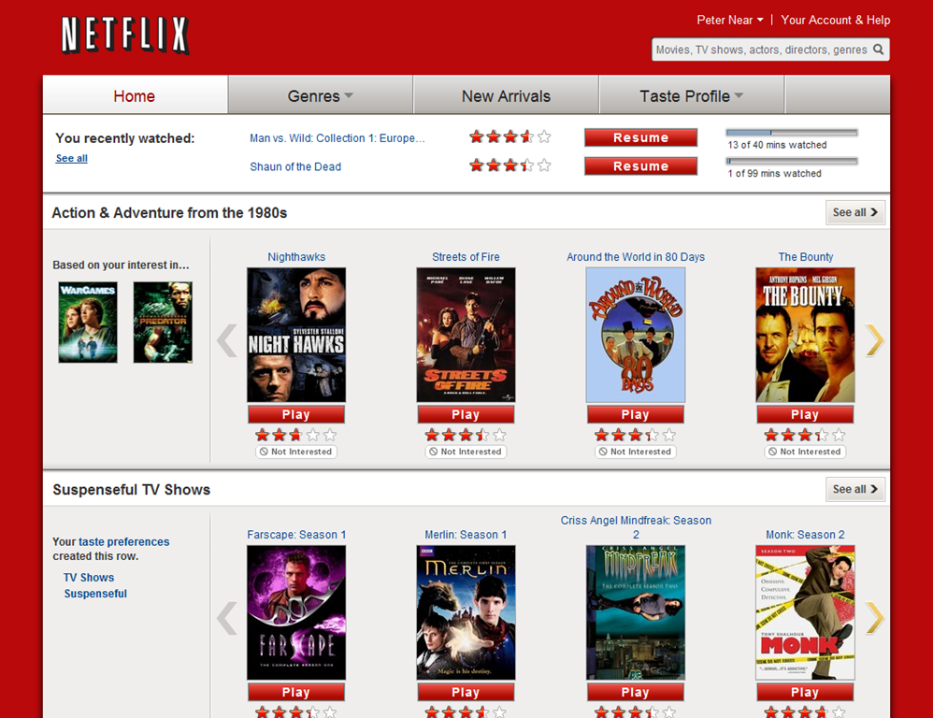

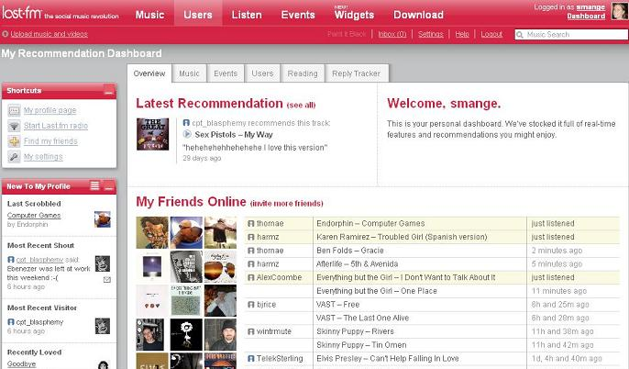
Introduction
Recommender Systems
Software tools and techniques providing users with suggestions for items a user may wish to utilize

Slide 3
Collaborative Filtering
Neighborhood models
Item item or user user similarities
Latent Factor
Transforms both users and items into the same latent space
Characterizing both by ratings
Matrix Factorization

Slide 4
What is Matrix Factorization?
Decomposing a large matrix into two smaller one
The dot product of the two should be equal to the original matrix
4X4
4X3
3X4
52 | 32 | 44 | 89
62 | 65 | 93 | 88
64 | 56 | 92 | 88
60 | 68 | 85 | 92
0 | 8 | 5
9 | 5 | 6
8 | 4 | 8
8 | 7 | 4
2 | 5 | 6 | 2
4 | 4 | 3 | 8
4 | 0 | 4 | 5

Slide 5
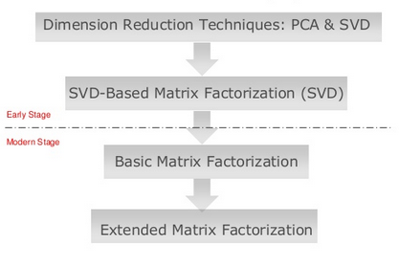
Matrix Factorization in Recommender Systems
The Evolution of MF in Recommender systems

Slide 6
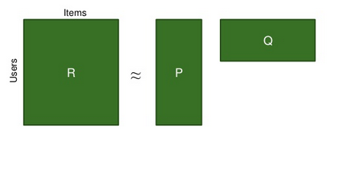
Matrix Factorization
Users | Spiderman | Limitless | Inception
U1 | 5 | 4 | 3
U2 | ? | 2 | 5
U3 | 5 | 5 | ?
n
n items
f
m users
m
R_{ui} = q_{i}^{T}. p_{u}
f

Slide 7
Matrix Factorization
P_{u} indicates how much user u likes f latent factors
Q_{i} shows how much item i obtains f factors
R_{ui} shows how much user u likes item i
The latent factors can be genre of movie such as romance, action, horror, adventure, comic, etc.
n
n items
f
m users
m
R_{ui} = q_{i}^{T}. p_{u}
f

Slide 8
Optimizing Factors
To find the best feature matrix that explains users (P) and items (Q) we should perform optimization
min Σ (r_{ui} - q_{i}^{T}p_{u})²
min Σ (r_{ui} q_{i}^{T}p_{u})²+ λ((||q_{i}||² + ||p_{u}||²)
The cost function in our optimization problem
Regularized item is added to avoid over-fitting

Slide 9
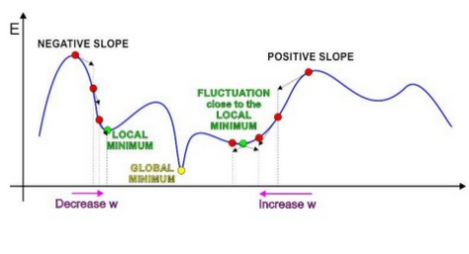
Optimizing Factors
Optimization is performed using Stochastic Gradient Descent (SGD)

Slide 10
Optimizing Factors
First initialize both user and item matrices with a small random number
To modify the user and item matrices we first calculate the error from actual rating and the dot product of the P and Q matrices (predicted rating)
e_{ui} = r_{ui} – q_{i}^{T}p_{u}
It modifies parameters of p and q by a magnitude proportional to a predefined learning rate (γ) in the opposite direction of the gradient
q_{i} ← q_{i} + γ (e_{ui} * p_{u} – λ * q_{i} )
p_{u} ← p_{u} + γ (e_{ui} *q_{i} - λ * p_{u} )

Slide 11
Example
Users | Spiderman | Limitless | Inception
U1 | 5 | 4 | 3
U2 | ? | 2 | 5
U3 | 5 | 5 | ?
1. Initialize P and Q matrices
User | f1 | f2 | f3 | f4
U1 | 0.003 | 0.003 | 0.003 | 0.003
U2 | 0.003 | 0.003 | 0.003 | 0.003
U3 | 0.003 | 0.003 | 0.003 | 0.003
Movie | Spiderman | Limitless | Inception
f1 | 0.003 | 0.003 | 0.003
f2 | 0.003 | 0.003 | 0.003
f3 | 0.003 | 0.003 | 0.003
f4 | 0.003 | 0.003 | 0.003
2. Calculate R^_{ui} = q_{i}^{T}. p_{u}

Slide 12
Example
3. Calculate the error between predicted rating and the actual known rating
4. Refine the parameters of the matrices
5. Redo step 2-5 until convergence (or reach to the maximum number of iterations)

Slide 13
Example
Optimized Matrix:
Assume that the result is 3.203
Movie | Spiderman | Limitless | Inception
f1 | 1.553 | -0.345 | 0.772
f2 | -0.364 | 0.981 | -0.224
f3 | 0.305 | -1.345 | 1.567
f4 | 0.987 | 0.586 | -0.334
User | f1 | f2 | f3 | f4
U1 | 0.243 | 0.789 | -0.290 | -1.287
U2 | 1.543 | -0.647 | 0.834 | -0.303
U3 | 0.448 | -1.294 | -1.409 | 0.243
Users | Spiderman | Limitless | Inception
U1 | 5 | 4 | 3
U2 | ? | 2 | 5
U3 | 5 | 5 | ?

Slide 14

Accuracy Evaluation
Prediction Accuracy Evaluation
Precision Recall
Mean Absolute Error (MAE)
Root Mean Square Error (RMSE)
Notes:
But how do we evaluate accuracy? There are various techniques to evaluate the accuracy of recommendations. The most commonly used technique in the literature is RMSE

Slide 15
Root Mean Square Error (RMSE)
The lower the RMSE, the better the prediction
There is evidence that small improvements in RMSE terms can have a significant impact on the quality of the top few presented recommendations (Mehta et al. 2007)
There are several studies on extensions of MF to achieve higher accuracy

Slide 16
Extended Matrix Factorization
Adding biases to the basic algorithm
To account for personalization
b_{i} is the item bias to account for ex. popular items
b_{u} is users bias to account for ex. users who assign low rates
rˆ_{ui} = μ + b_{i} + b_{u} +q_{i}^{T}p_{u}
Global mean of all ratings
The deviation of mean of a specific user’s rating from global mean of all ratings
deviation of the mean of an item’s ratings from the mean of all available ratings

Slide 17
Extended Matrix Factorization
The system learns by minimizing the squared error factor:
min Σ (r_{ui}- μ - b_{i} - b_{u} - q_{i}^{T}p_{u})²+ λ((||q_{i}||² + ||p_{u}||²+ b_{i}² +b_{u}²)
Learning algorithms used is stochastic gradient descent loop
b_{i} ← b_{i} + γ (e_{ui} – λ * b_{i} )
b_{u} ← b_{u} + γ (e_{ui} - λ * b_{u} )
q_{i} ← q_{i} + γ (e_{ui} * p_{u} – λ * q_{i} )
p_{u} ← p_{u} + γ (e_{ui} *q_{i} - λ * p_{u} )
Notes:
The algorithm loops through all ratings in training set and calculates estimated ratings for each user-item characteristic Then, the error associated with the prediction is calculated (e_{ui}). Consequently, it modifies parameters of p and q by a magnitude proportional to a predefined learning rate in the opposite direction of the gradient. The result will be as follows

Slide 18
Globe and Mail Project

Slide 19
Research Problem
Build an offline model to predict clickthrough on Automobile ads, using an algorithm that we can score in javascript on a webpage
Redefine their advertisement pricing strategy

Slide 20
Data Sets
Raw Omniture Desktop
Analytic Omni Data
Monetization Data
Solr
WebCrawl
Advertising Data
Doubleckick advertising data
Clicks
Impressions

Slide 21
Data Preparation
Extract month long clicks and Impressions data on Auto advertisement from October 1st until October 31st 2014
Data cleaning and processing
Exploratory analysis
To find potential correlations between variables

Slide 22
User Matrix
UserId
Location
CountryId,RegionId,CityId,PostalCodeId
Browser information
BrowserId,OSId,OSVersion
Instrument
MobileDevice,MobileCapability
3,012,634 unique Users
Zipped file size: 65.5 Mb

Slide 23
Advertisement Matrix (Item Matrix)
Adid
AdvertiserId,OrderId,LineItemId,CreativeId,CreativeSize,AdUnitId
Clicks_yn
CustomTrageting information
arena1,arena2,arena3,ekw1,ekw2,ekw3,adpg,atpc, mode, loc, pp0, pos
517477 distinct advertisement
Zipped file size: 11Mb

Slide 24
User-item Matrix
Clicks_yn
UserId
AdId
Number of clicks by a user on specific ad
Number of impression by a user of a specific ad
Calculated click through rate for each User-ad pair
5,859,921 Observations
File size: 355 Mb

Slide 25
Rating Matrix
UserId (transformed to numerical)
AdId (transformed to numerical)
Click through rate for each User-ad pair
Transformation of the rate into 1-5 scale
OldRange = (OldMax - OldMin)
NewRange = (NewMax - NewMin)
NewValue = (((OldValue - OldMin) * NewRange) / OldRange) + NewMin
5,859,921 Observations

Slide 26
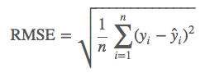
Algorithm Implementation
Matrix Factorization was performed using MATLAB
Number of features was selected to be 6 and number of epochs to be 29
Some other commonly used combinations were also tested but these initial values seems to generate optimal results
The accuracy measure used is RMSE (Root Mean Square Error)

Slide 27
Reduced Rating Matrix
Sampled 0.5% of the whole data set
96095 Observations
Split into training and test dataset
80% training and 20% test
Train set :66305 & Test set : 16564
RMSE = 0.1078

Slide 28
Rating Matrix
Used the whole data set
5,859,921 Observations
Split into training and test dataset
80% training and 20% test
Train set :4076466 & Test set : 1019117
RMSE = 0.0995

Slide 29
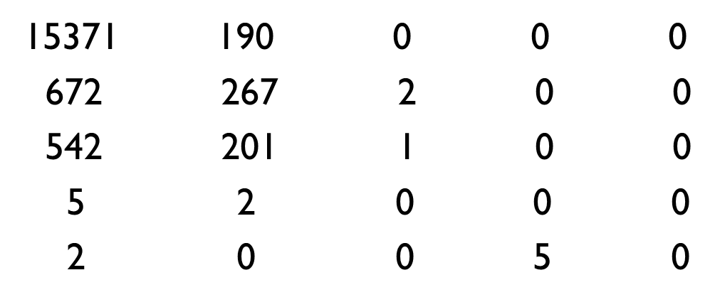
Confusion matrix
Actual classes
1 |  | 2 | 3 | 4 | 5
1
2
3
4
5
Predicted classes

Slide 30
Confusion matrix-Percentage
Actual classes
 | 1 | 2 | 3 | 4 | 5
1 | 92.64% | 28.79%
2 | 4.05% | 40.45% | 66%
3 | 3.02% | 30.45% | 33%
4 |  | 0.3%
5 |  |  |  | 100%
Predicted classes

Slide 31
Further Analysis
Data was too sparse and the predictions were basically made on zero elements and hence too accurate
Selected a sample data that had the sparsity of 10% to test our algorithm on non zero click through predictions
The result : RMSE = 0.4122

Slide 32
Conclusion
Matrix Factorization algorithm works well to detect click through rate prediction if the sparsity problem can be mitigated
Suggestions to mitigate sparsity
Consider active customers only
Non active users will have 0 click-through rate
Consider groups of advertisement in one campaign
Bundling advertisers group may increase the number of none zero click-through rate

Slide 33
Experiments

Slide 34
Experiment
Movielens 1M
1,000,209 anonymous ratings
UserIDs range between 1 and 6040
MovieIDs range between 1 and 3952
Ratings are made on a 5-star scale (whole-star ratings only)
Each user has at least 20 ratings

Slide 35
Results
Matrix Factorization
RMSE = 0.8917
Time = 799.355 s
Predicted Rating
63% | 33% | 7% | 1% | 0%
20% | 34% | 18% | 5% | 1%
10% | 24% | 40% | 22% | 6%
6% | 1% | 7% | 28% | 64%
2% | 1% | 7% | 28% | 64%
Actual Rating

Slide 36
Results
Extended Matrix Factorization with baseline biases
RMSE = 0.8856
Time = 825.816 s
Predicted Rating
69% | 32% | 7% | 1% | 0%
20% | 34% | 18% | 4% | 1%
8% | 25% | 40% | 21% | 5%
2% | 1% | 7% | 29% | 67%
1% | 1% | 7% | 29% | 67%
Actual Rating

Slide 37
Cluster based MF
Two step algorithm
Applied Biased MF on training to find baseline matrix for user and item
Applied K-means with k=20 to find similar users
Used one single feature for all similar users, which was the mean of all the previously calculated 6 latent features
Applied Biased MF one more time on 1 feature

Slide 38
Results
Clustering based Matrix factorization
RMSE = 0.9080
Predicted Rating
67% | 30% | 7% | 2% | 0%
19% | 33% | 17% | 5% | 1%
10% | 27% | 39% | 21% | 6%
3% | 2% | 8% | 29% | 66%
1% | 2% | 8% | 29% | 66%
Actual Rating

Slide 39
The new Experiment
Keep the same feature matrix learned through training
Change the new rating to be the mean of the ratings for all similar users in each cluster
RMSE = 1.2753
Predicted Rating
11% | 14% | 6% | 5% | 7%
13% | 17% | 12% | 10% | 13%
22% | 28% | 27% | 25% | 28%
30% | 13% | 21% | 24% | 19%
24% | 13% | 21% | 24% | 19%
Actual Rating

Slide 40
The new Experiment
Cluster should be calculated as clusterBiases
Cluster Biases should be calculated while estimating biases
Should be redefined in the learning phase through Gradient Descent
Should be used in testing phase

Slide 41
Questions & comments
Parisa Lak

